Slide 1
Intrusion Detection System based on Efficient Clustering and Classification Algorithms
Main Project Supervisor 1.K.Keerthana (16341A0583)
Mr.P.Srikanth 2. K.R.Dinakar(16341A0597)
Asst.Professor, 3. M.Eswar Kalyan(16341A05B9)
Dept. of CSE, 4. B.Ananda Raju(16345A0506)
GMRIT. 5.P.Monica(13341A05C3)

Slide 2
Abstract
Intrusion detection is a critical component of secure information systems. By elimination of the insignificant or useless inputs leads to a simplification of the problem, faster and more accurate detection may result. Social networking, business, education everything we perform through internet. As the users increases this will lead to more vulnerable towards attacks for this continuous monitoring of network is necessary where IDS (Intrusion Detection Systems) is used as monitoring purpose. As the aim of IDS is to detect various types of malicious network traffic and computer usage, which cannot be detected by a conventional firewall. Intrusion detection system is a device or application that actively monitor the network from malicious activities. By the use of clustering algorithms we can detect new or unknown type of intrusions from our training data. In our project we are trying to analyze the NSL-KDD dataset using PCA (Principal Component Analysis) and possible clustering algorithm. And classification algorithms are applied to analyze the performance of the dataset
Keywords: Intrusion Detection System (IDS), Clustering, Classification , NSL -KDD data,Unsupervised and supervised learning techniques

Slide 3
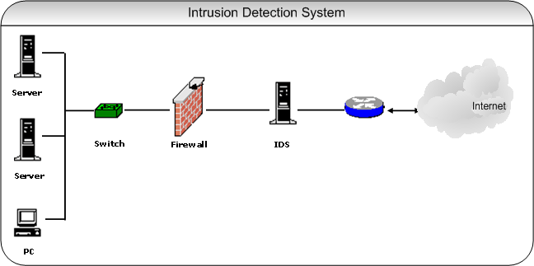
Introduction
Intrusion Detection System:
An Intrusion Detection System (IDS) is a system that monitors network traffic for suspicious activity
and issues alerts to an administrator when such activity is discovered. Intrusion detection is based on the
assumption that the behavior of the intruder differs from that of a legitimate user

Slide 4
Dataset Description:
The dataset to be used in our project is the NSL-KDD dataset which is a new dataset used in network intrusion detection system.
It consists of selected records of the complete KDD 99 dataset. NSLKDD dataset solve the issues of KDD 99 benchmark and connection record contains 41 features.
Among the 41 features, 34 features are numeric and 7 features are symbolic or discrete.
The NSL-KDD training set contains a total of 24 training attack types; with an additional 17 types in the testing set only.
The data contains 24 attack types that could be classified into four main categories:
• DOS: Denial Of Service attack.
• R2L: Remote to Local (User) attack.
• U2R: User to Root attack.
•Probing: Surveillance and other probing.

Slide 5
Literature Survey
1.Sharmila Kishor Wagh, Vinod K. Pachghare, Satish R. Kolhe “Survey on Intrusion Detection System using Machine Learning Techniques “Volume 78 – No.16, September 2013 :
This paper reviews different machine approaches for Intrusion detection system. This paper also presents the system design of an Intrusion detection system to reduce false alarm rate and improve accuracy to detect intrusion. Machine Learning is one of the technique used in the IDS to detect attacks. Every day new kind of attacks is being faced by industries. One of the solutions to this problem is by using Intrusion Detection System (IDS). Detection System (IDS) is designed to detect system attacks and classify system activities into normal and abnormal form. Machine learning techniques have been applied to intrusion detection systems which have an important role in detecting Intrusions.

Slide 6
2.L.Dhanabal1, Dr. S.P. Shantharajah2 “A Study on NSL-KDD Dataset for Intrusion Detection
System Based on Classification Algorithms “ Vol. 4, Issue 6, June 2015 :
A data set with a sizable amount of quality data which mimics the real time can only help to train and
test an intrusion detection system. The NSL-KDD data set is a refined version of its predecessor KDD
99 data set. In this paper the NSL-KDD data set is analysed and used to study the effectiveness of the
various classification algorithms in detecting the anomalies in the network traffic patterns. Analysis of
NSL-KDD data set is made by using various clustering algorithms available in the WEKA data mining
tool. K-means clustering algorithm uses the NSL-KDD data set to train and test various existing and
new attacks.

Slide 7
3.Shilpa lakhina, Sini Joseph and Bhupendra verma “ Feature Reduction using Principal Component Analysis for Effective Anomaly–Based Intrusion Detection on NSL-KDD “ Vol. 2(6) :
In this paper PCA (principal component analysis) transform used to reduce the feature and trained neural network is used to identify the any kinds of new attacks. Test and comparison are done on NSL-KDD dataset. It is a new version of KDDcup99 and has some advantages over KDDcup99, the experiments with NSL-KDD data demonstrate that our proposed model gives better and robust representation of data as it was able to reduce features resulting in a 80.4% data reduction, approximately 40% reduction in training time and 70% reduction in testing time is achieved. Our proposed method not only reduces the number of the input features and time but also increases the classification accuracy.

Slide 8
4.Wei-ChaoLin ,Shih-WenKe,Chih-FongTsai “An intrusion detection system based on combining cluster centers and nearest neighbors” Volume 78,April 2015:
In this approach, two distances are measured and summed, the first one based on the distance between each data sample and its cluster center, and the second distance is between the data and its nearest neighbor in the same cluster. Then, this new and one-dimensional distance based feature is used to represent each data sample for intrusion detection by a k-Nearest Neighbor (k-NN) classifier. Specifically, given a dataset, the k-means clustering algorithm is used to extract cluster centers of each pre-defined category. Then, the nearest neighbor of each data sample in the same cluster is identified. Next, the sum of the distance between a specific data sample and the cluster centers and the distance between this data sample and its nearest neighbor is calculated. This results in a new distance based feature that represents the data in the given dataset

Slide 9
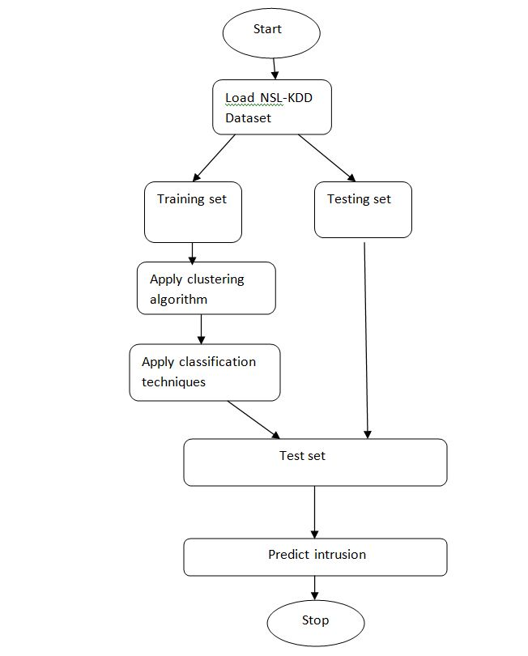
Methodology
Flowchart:

Slide 10
PCA Algorithm
Organize the data set
Calculate the empirical mean
Calculate the deviations from the mean
Find the covariance matrix
Find the eigenvectors and eigenvalues of the covariance matrix
Rearrange the eigenvectors and eigenvalues
Select a subset of the eigenvectors as basis vectors

Slide 11
Clustering Algorithm
K-means clustering algorithm :
The K-means clustering algorithm is used to find groups which have not been explicitly labelled in the data.
If k is given, the K-means algorithm can be executed in the following steps:
• Partition of objects into k non-empty subsets
• Identifying the cluster centroids (mean point) of the current partition.
• Assigning each point to a specific cluster
• Compute the distances from each point
• allot points to the cluster where the distance from the centroid is minimum
• K-means re-assigns each record in the dataset to the most similar cluster

Slide 12
Classification Techniques
Decision tree classification :
A Decision tree is a flowchart like tree structure, where each internal node denotes a test on an attribute, each branch represents an outcome of the test, and each leaf node (terminal node) holds a class label.
Place the best attribute of the dataset at the root of the tree.
Split the training set into subsets. Subsets should be made in such a way that each subset contains data with the same value for an attribute.
3. Repeat step 1 and step 2 on each subset until you find leaf nodes in all the branches of the tree.

Slide 13
KNN classification:
K nearest neighbor algorithm is very simple. It works based on minimum distance from the
query instance to the training samples to determine the K-nearest neighbors.
1. Calculate the distance between test data and each row of training data. Here we will use
Euclidean distance as our distance metric since it’s the most popular method. The other
metrics that can be used are cosine etc.
2. Sort the calculated distances in ascending order based on distance values
3. Get top k rows from the sorted array
4. Get the most frequent class of these rows
5. Return the predicted class

Slide 14
Procedure
Step 1: convert the input dataset into numerical
Step 2: load the converted dataset as input
Step 3: Apply PCA algorithm to given dataset and get the dimensionally reduced dataset.
Step 4: apply k-means technique for k clusters
Step 5: identify the cluster centroids
Step 6: find the distance between each record and cluster centroids
Step 7: then obtain the reduced dataset
Step 8: apply classification technique
Step 9: measure the accuracy

Slide 15
Case study for pca
Input data:
A1 | A2 | A3 | A4 | A5
5 | 3 | 0 | 1 | 5
10 | 15 | 3 | 5 | 6
15 | 12 | 7 | 6 | 22
24 | 10 | 2 | 3 | 6
30 | 45 | 7 | 6 | 22

Slide 16
Covariance matrix:
Eigen values:
A1 | A2 | A3 | A4
-11.8 | -14. | -3.8 | -3.2
-6.8 | -2. | -0.8 | 0.8
-1.8 | -5. | 3.2 | 1.8
7.2 | -7. | -1.8 | -1.2
13.2 | 28. | 3.2 | 1.8
341.05567842 | 34.10525426 | 7.04150521 | 0.39756212

Slide 17
Eigen vectors:
Reduced data:
-0.47625596 | -0.87879813
-0.86755249 | 0.47334817
-0.12028981 | 0.03248977
-0.07786713 | 0.05098786
A1 | A2 | A3
18.471831 | 3.456321 | 5
5.007584 | 5.043929 | 6
4.669935 | -0.589159 | 22
2.953787 | -9.760451 | 6
-31.103137 | 1.849359 | 22

Slide 18
Case study for K-means
Input data set:
cluster centroids for K=2
A1 | A2 | A3 | A4 | A5
5 | 3 | 0 | 1 | 5
10 | 15 | 3 | 5 | 6
15 | 12 | 7 | 6 | 22
24 | 10 | 2 | 3 | 6
30 | 45 | 7 | 6 | 22
 | A1 | A2 | A3 | A4 | A5
Centroid I | 13.5 | 10 | 3 | 3.75 | 9.75
Centroid II | 30 | 45 | 7 | 6 | 22

Slide 19
Distance between each record and cluster centroids
Distance for Centroid I | Distance for Centroid II
12.66 | 52.45
7.27 | 39.66
13.31 | 36.24
11.21 | 39.38
40.84 | 0

Slide 20
Cluster generated for each record
A1 | A2 | A3 | A4 | A5 | Cluster
5 | 3 | 0 | 1 | 5 | 0
10 | 15 | 3 | 5 | 6 | 0
15 | 12 | 7 | 6 | 22 | 0
24 | 10 | 2 | 3 | 6 | 0
30 | 45 | 7 | 6 | 22 | 1

Slide 21
Results
Accuracy for various classification techniques
Classification algorithm | without data reduction | With PCA | With K-means | With data reduction
Decision Tree | 60.63 | 60.33 | 90.99 | 92.99
K Nearest Neighbour | 88.25 | 86.05 | 92.00 | 94.99

Slide 22
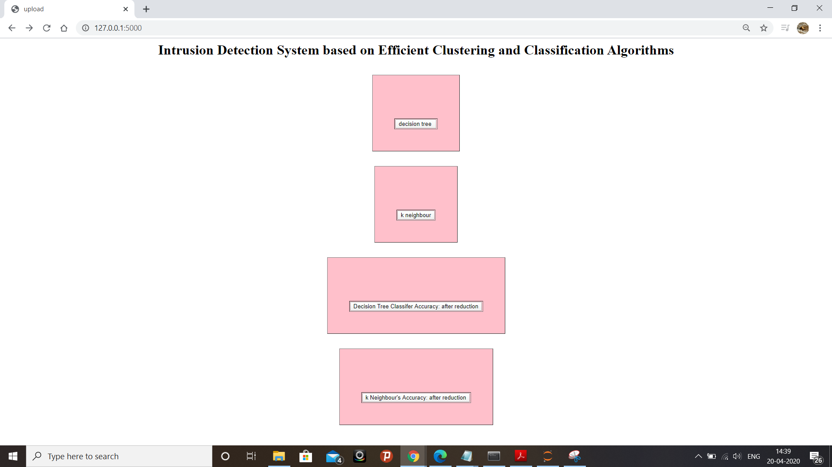
Web Interface for Clustering and Classification for Intrusion Detection System

Slide 23
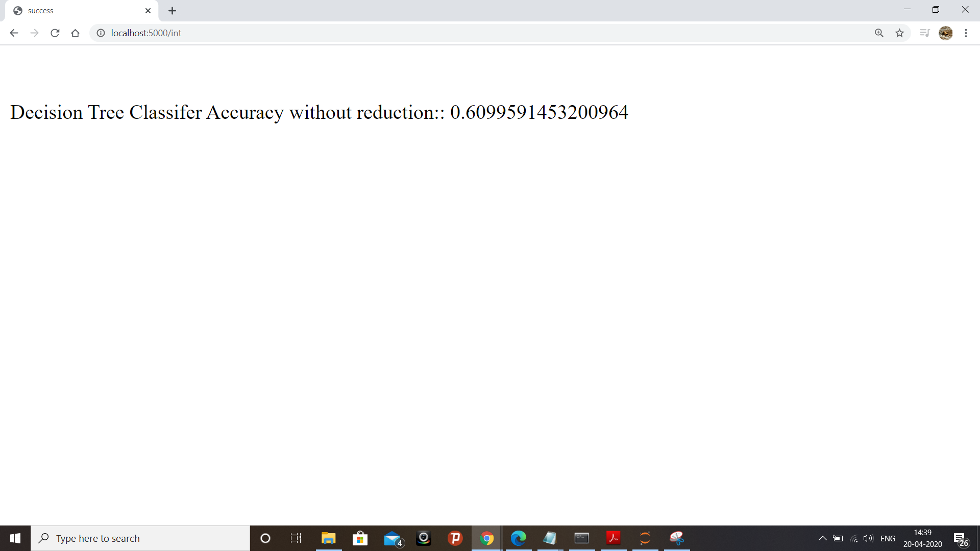

Slide 24


Slide 25


Slide 26


Slide 27
Conclusion
With the proposed methodology, we get the reduced dataset for the given NSL KDD dataset using PCA with K-means algorithms that works on dimensionality reduction. Clustering algorithms prove to be very useful when we have a huge amount of unlabeled dataset. And then we measure the accuracy using classification techniques which results in high accuracy when compared to the accuracy that was measured before data reduction.
As a future extension for the present research, there is a scope and possibility to come up with new measures and classifiers that can improve the classification and detection accuracies of low-frequency attacks such as U2R and R2L.

Slide 28
References
1. Wei-Chao Lin , Shih-Wen Ke , Chih-Fong Tsai,"CANN: An intrusion detection system based on
combining cluster centers and nearest neighbors",Journal of Knowledge-Based Systems 78 (2015).
2. L.Dhanabal1, Dr. S.P. Shantharajah2 “A Study on NSL-KDD Dataset for Intrusion Detection System Based on Classification Algorithms “ Vol. 4, Issue 6, June 2015.
3. Sharmila Kishor Wagh, Vinod K. Pachghare, Satish R. Kolhe “Survey on Intrusion Detection System using Machine Learning Techniques “Volume 78 – No.16, September 2013.
4. Shilpa lakhina, Sini Joseph and Bhupendra verma “ Feature Reduction using Principal Component Analysis for Effective Anomaly–Based Intrusion Detection on NSL-KDD “ Vol. 2(6).

